Slide 1
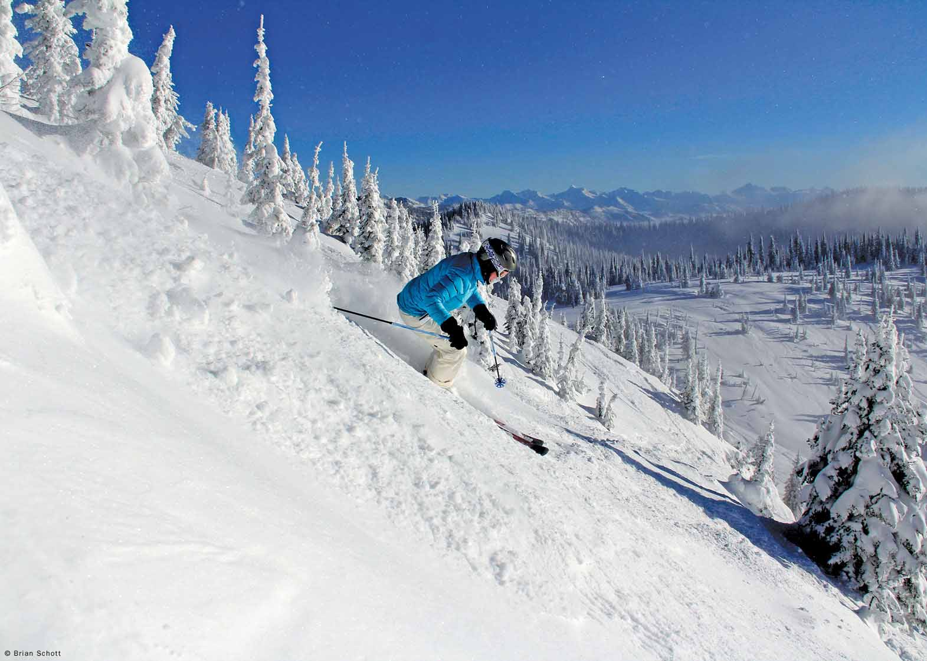
Big Mountain Resort Pricing Model
Andy Clark
November 1, 2021

Slide 2
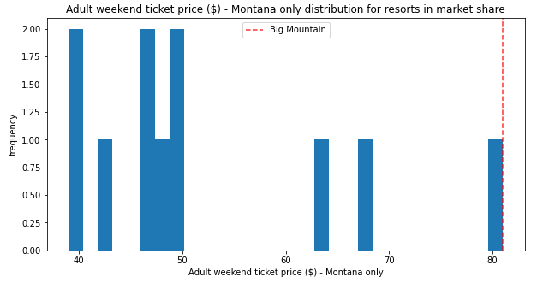
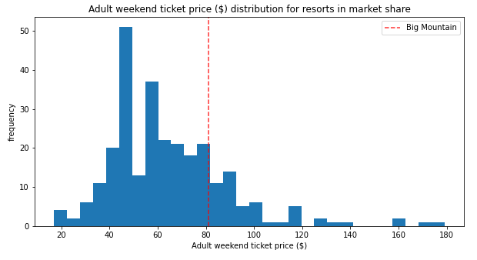
Big Mountain Resort Lift Ticket Pricing
Big Mountain Resort (BMR) current pricing is the most expensive in the local Montana market, and slightly higher than average of a larger market segment at $81/ticket.
The current price does not account for BMR’s physical features.
+$15
Current Price $81
Model Price $96
Including BMR’s specific features into the pricing model suggests the current lift ticket price should be $96.

Slide 3
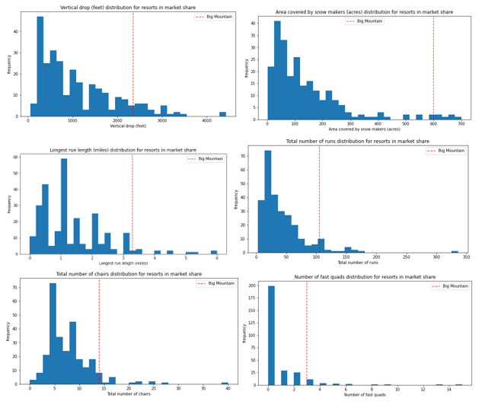
Recommendation and Findings
Data for 276 resorts including ticket price and features of the resorts were compiled
Identified 6 main drivers of ticket price
The distribution of the 6 main driver plotted to the right indicate BMR is located on the high end of these favorable pricing features
Recommendation
Include BMR features into the pricing model.

Slide 4
Modeling Results and Analysis
Model Preprocessing for Linear Model and Random Forest
Cross Validation performed on a 70% train, 30% test split
K best feature analysis to prevent overfitting
Identified the most important features to pricing
Both models identified these important pricing features:
Number of fast quad lifts
Number of runs
Acres of snow making
Vertical

Slide 5
Modeling Results and Analysis
Final Model Selection
The random forest model has a lower cross validation error of almost $1 and has less variability. On the test data set, the random forest produces performance consistent with the cross validation results.
The random forest model was chosen to model ticket price.
Cross Validation | Random Forest | Linear Regression
Mean Absolute Error | $9.64 | $10.50
Standard Deviation | $1.35 | $1.62
Test Mean Absolute Error | $9.53 | $11.79

Slide 6
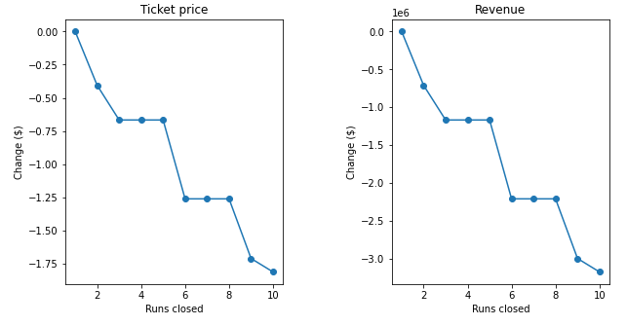
Modeling Results and Analysis
Model Scenario, Operational Improvement Opportunity
The model suggests by closing a few runs there could be none to a small amount of lost revenue. Closing a small number of runs could reduce the operational cost enough to offset the lost revenue.
An additional study to verify the economics of closing a limited number of runs could increase profitability.

Slide 7
Summary and Conclusion
By including the features that BMR currently offers, the pricing model suggests $95 per adult weekend lift ticket is the fair market value.
+$15
Current Price $81
Model Price $96

